Slide 1
Projektpraktikum Human Activity Understanding
Grand Master Chess Demo
Group C
Berkay Silsüpür
Gjergji Luarasi
27.07.2022

Slide 2
Outline
Objectives
Tools Used
Setup & Data Collection
Data Annotation & Exporting
Training & Testing on GPU server
Using Test Outputs
Method & Features
Implementation
Visualization
Limitations
Conclusion & Future Work
Berkay Silsüpür - Grand Master Chess Demo

Slide 3
Objectives
Detect and classify the chess pieces from a recorded game using a deep learning model
Use model’s predictions to estimate the state of the chess game with computer vision methods
Visualize the game using a digital twin board to keep track of the moves played
Berkay Silsüpür - Grand Master Chess Demo

Slide 4

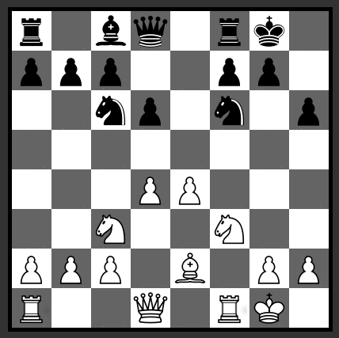
Objectives
Recorded Test Sequence as input
Board Visualizer (example image) to keep track of the moves frame by frame as the aimed output
Berkay Silsüpür - Grand Master Chess Demo

Slide 5





Tools Used
Gitlab ⇒ working environment
CVAT ⇒ data annotation
YOLO v3 ⇒ deep learning model
Python ⇒ programming
Python libraries ⇒ opencv, chess-board, MediaPipe, shapely, etc.
Berkay Silsüpür - Grand Master Chess Demo

Slide 6
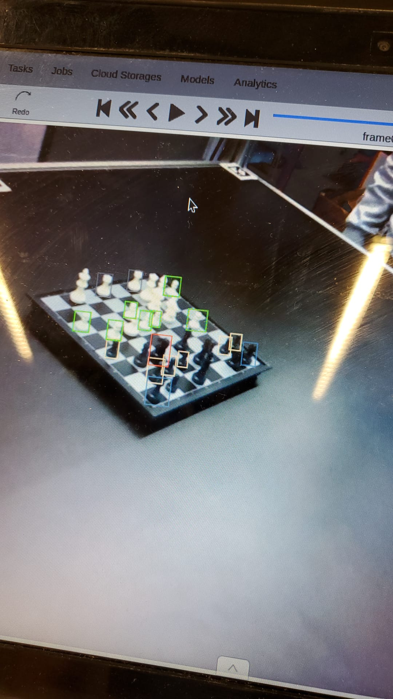
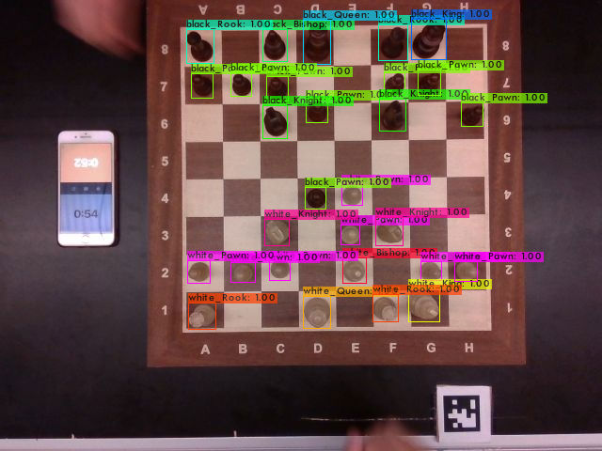
Setup & Data Collection
Recording with the old board in homework 2
Training with Yolo ⇒ bad results due to low quality images
A bigger board to increase the quality of the recorded data ⇒ much better results
Old Board
New Board
Berkay Silsüpür - Grand Master Chess Demo

Slide 7
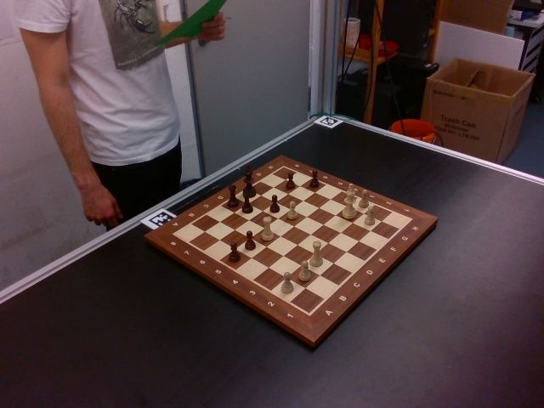
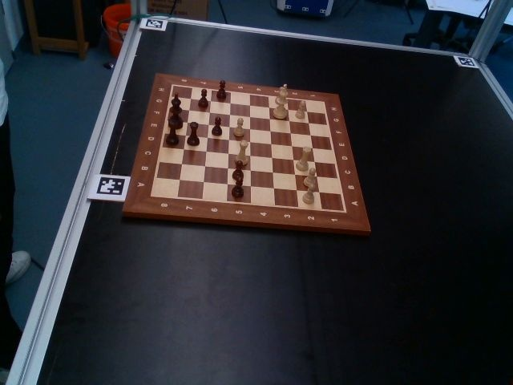
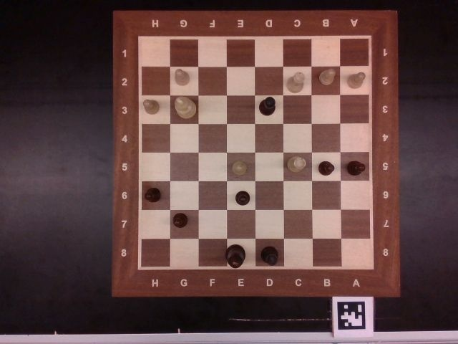
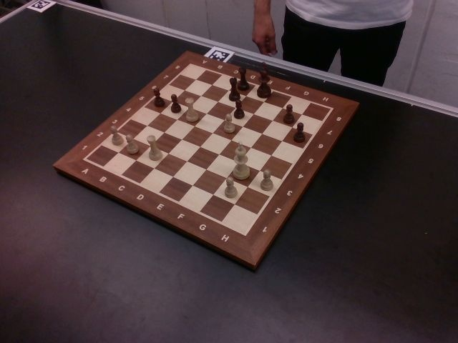
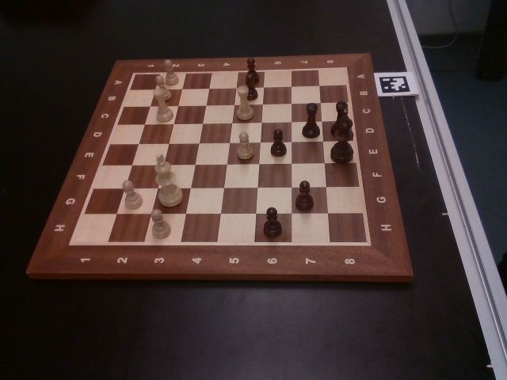
Setup & Data Collection
Camera Setup: 5 different angles to record multiple sequences
Camera 1
Camera 2
Camera 4
Camera 3
Camera 5
Berkay Silsüpür - Grand Master Chess Demo

Slide 8
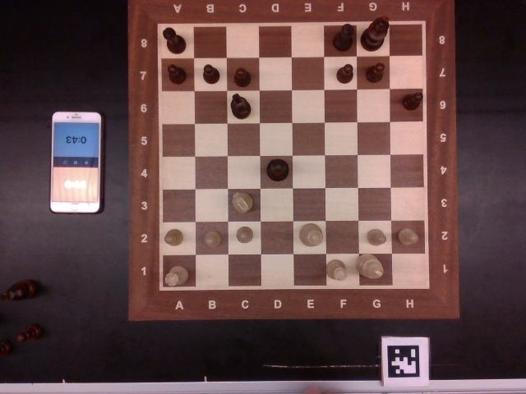
Setup & Data Collection
Only camera 4 to create our custom dataset
Reasons ⇒ clear angle, no overlap, 2 members for annotation, limited time
Image extraction from rosbag files
Dataset ⇒ 180 train, 70 test images
Sample image from Camera 4
Berkay Silsüpür - Grand Master Chess Demo

Slide 9
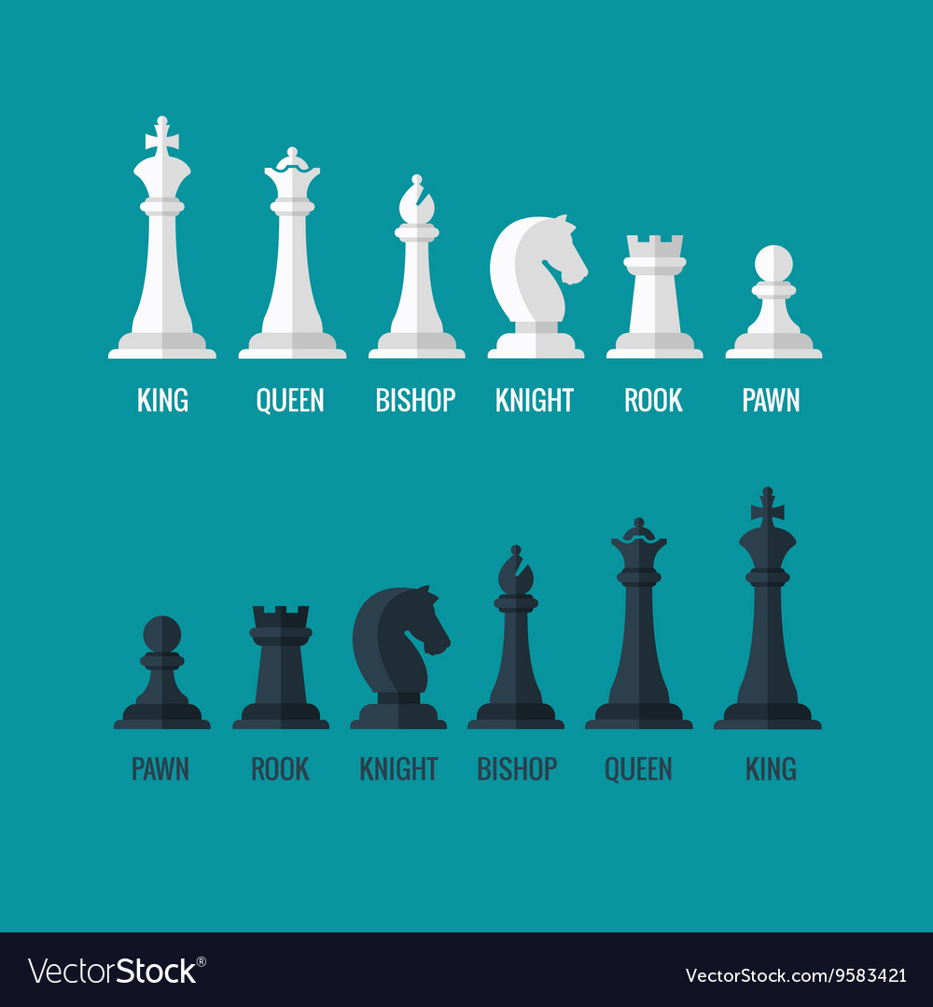
Data Annotation & Exporting
CVAT for annotating the dataset
Rectangle trackers for compatibility with Yolo
12 different classes are defined:
Labelled dataset is exported from CVAT with Yolo format
White Pawn
White Knight
White Bishop
White Rook
White Queen
White King
7. Black Pawn
8. Black Knight
9. Black Bishop
10. Black Rook
11. Black Queen
12. Black King
12 classes of chess pieces
Berkay Silsüpür - Grand Master Chess Demo

Slide 10
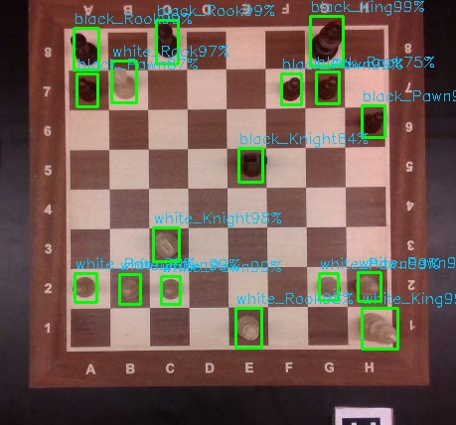
Training & Testing
Yolov3 model is trained on GPU server
Testing to observe the accuracy of detection and classification
Good accuracy on the testset
example test image with correct predictions
Berkay Silsüpür - Grand Master Chess Demo

Slide 11

Method & Features
Object oriented paradigm
chessPiece - as core class
Functional code
utils.py - contains functions like:
get chessboard tiles
get chess pieces
yolo initialization
digital twin update
Gjergji Luarasi - Grand Master Chess Demo

Slide 12

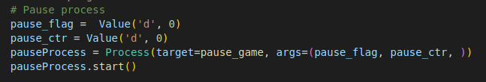

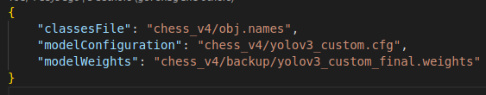
Method & Features
Multi processing used for interacting
pauseProcess - a process for pausing the game on Spacebar button press
Configuration using files
yolo_init.json - json configuration file used for initializing weights, class names and config
Gjergji Luarasi - Grand Master Chess Demo

Slide 13
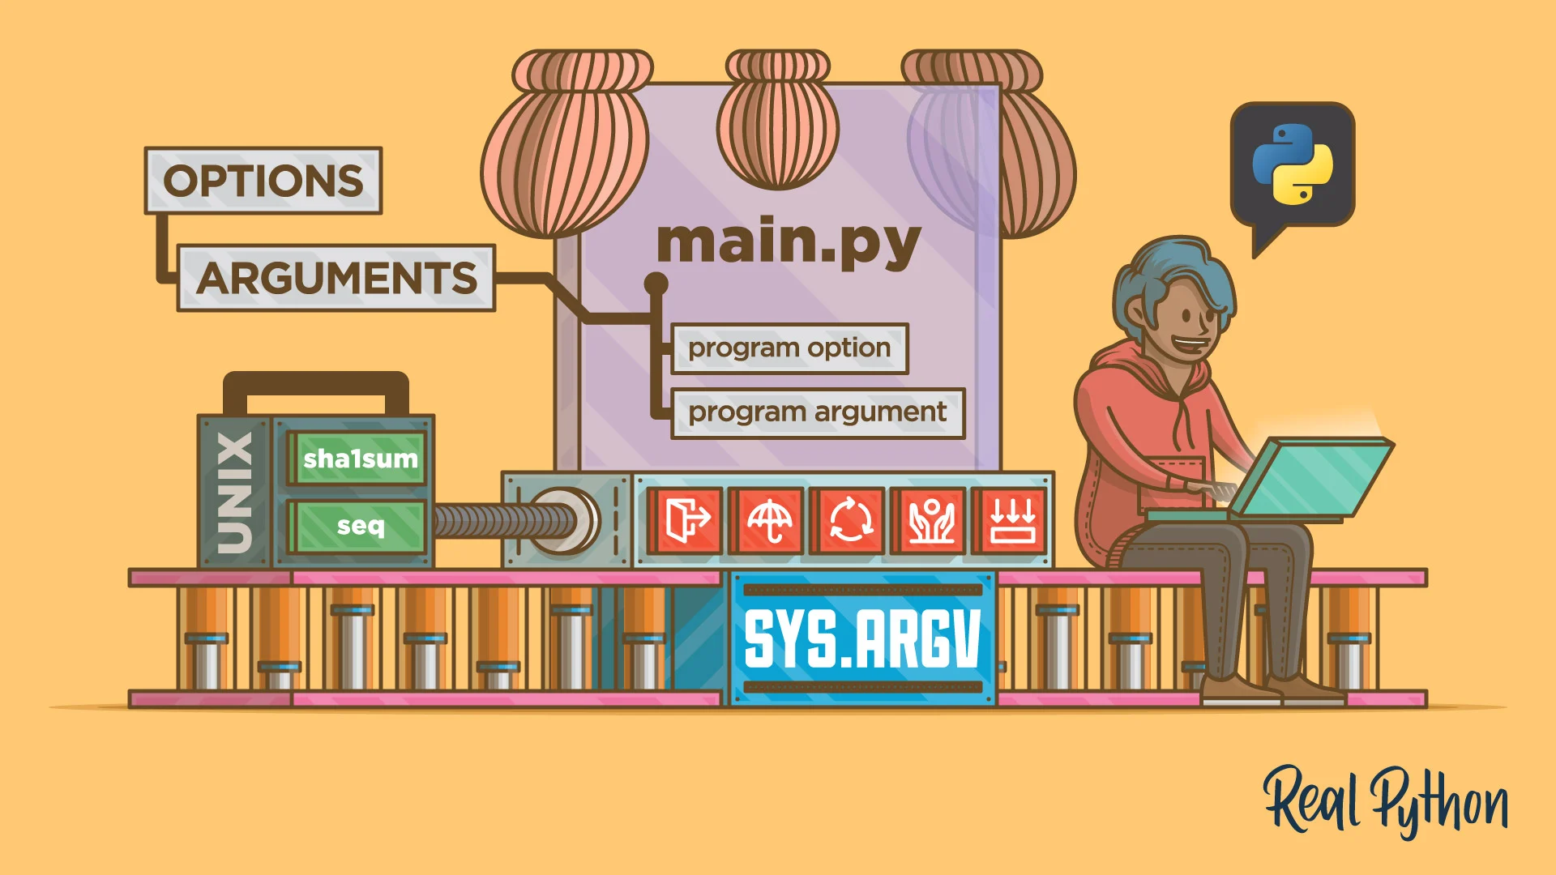
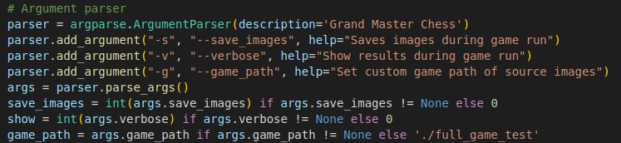
Method & Features
Argument parsing
cmd arguments used for different modes of operations:
  save_images
  show
  game_path
Gjergji Luarasi - Grand Master Chess Demo

Slide 14
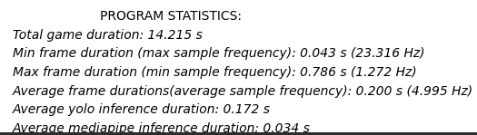
Method & Features
Printing program statistics:
game, frame, Yolo, MediaPipe durations
frame sampling frequency
Example:
Gjergji Luarasi - Grand Master Chess Demo

Slide 15
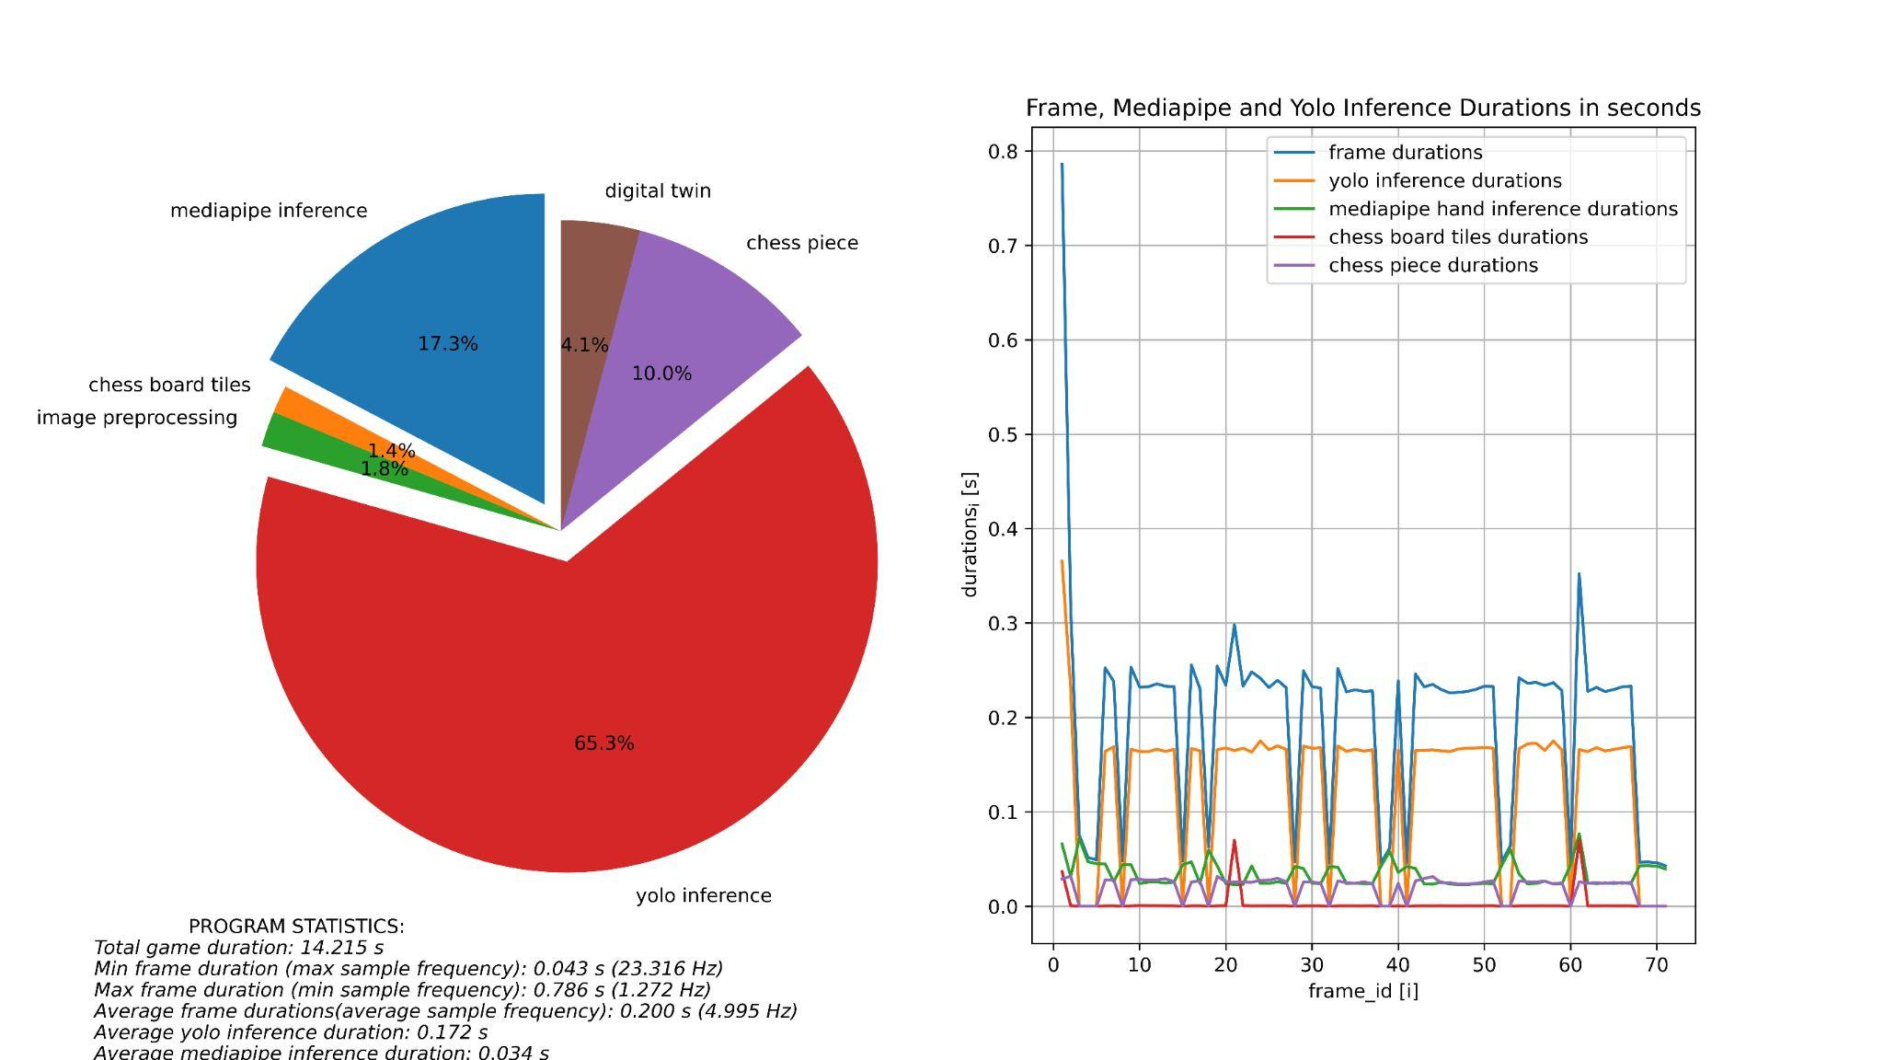
Program Statistics
Gjergji Luarasi - Grand Master Chess Demo

Slide 16
Implementation
Problem broken down into multiple steps
Pipeline:
Detect chessboard tiles and save into a dict
Filter out frames with hands
Update chessboard tiles every 20 frames
Image loading and preprocessing
Yolo darknet inference
Chess piece list generation
Display digital twin chess board
Gjergji Luarasi - Grand Master Chess Demo

Slide 17
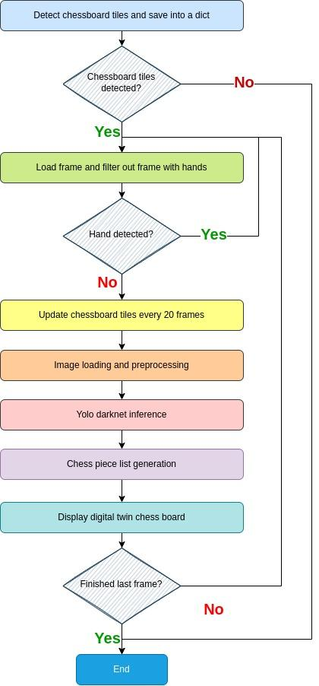
Implementation
Program flowchart:
Gjergji Luarasi - Grand Master Chess Demo

Slide 18
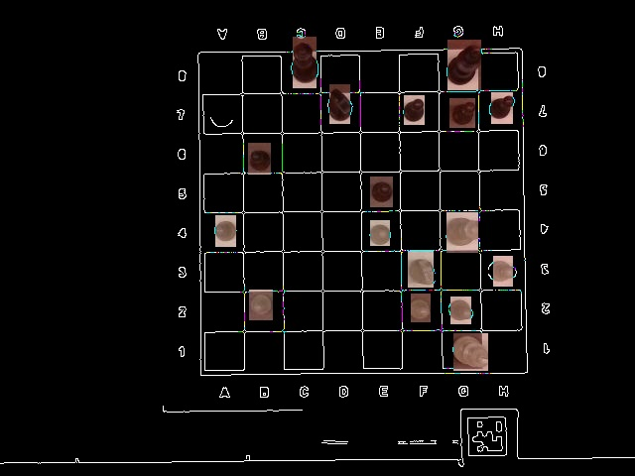
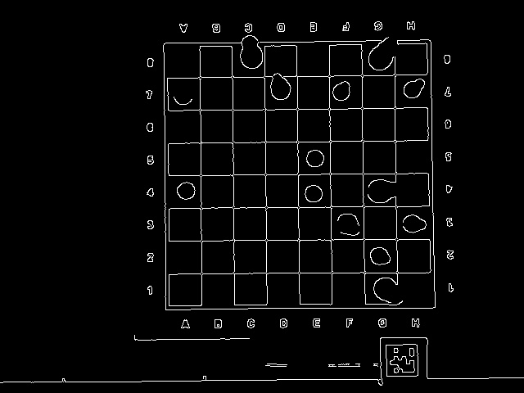
Canny edge - Chessboard Tile Detection Trial
Gjergji Luarasi - Grand Master Chess Demo

Slide 19
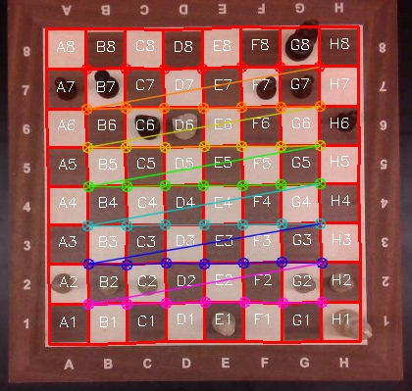
Chessboard Tiles Detection
Using opencv’s function the inner 7 by 7 corners of the board were found and then using mean distances the outer ones are computed
ret, corners = cv2.findChessboardCornersSB(gray, CHECKERBOARD, cv2.CALIB_CB_ADAPTIVE_THRESH + cv2.CALIB_CB_ACCURACY+ cv2.CALIB_CB_NORMALIZE_IMAGE + cv2.CALIB_CB_FAST_CHECK)
Gjergji Luarasi - Grand Master Chess Demo

Slide 20
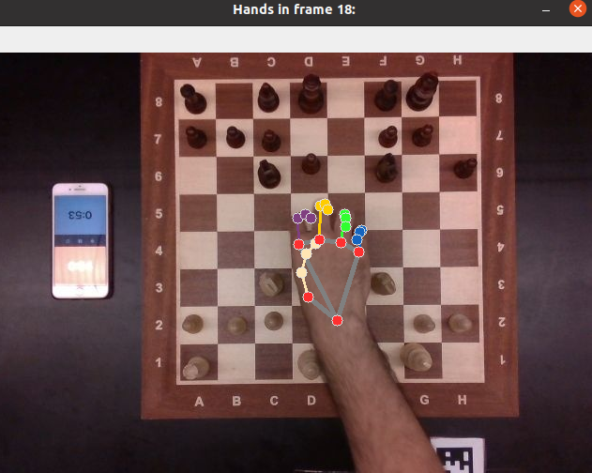
Handedness detection with MediaPipe
Frames that include hands are skipped using MediaPipe to avoid piece occlusions
Hand detection (frame removed)
Gjergji Luarasi - Grand Master Chess Demo

Slide 21
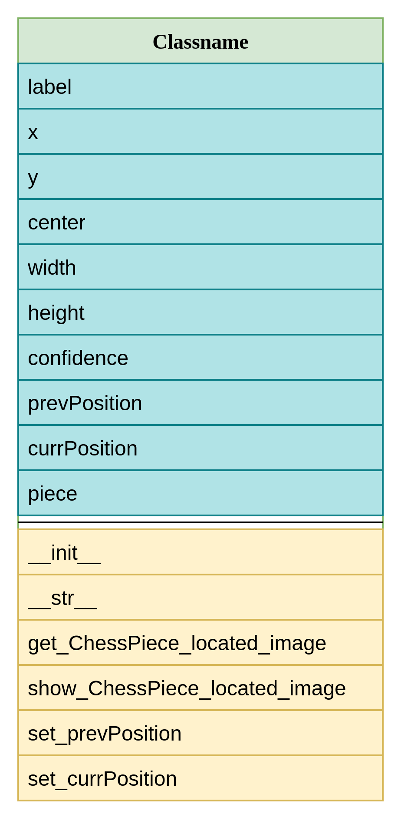
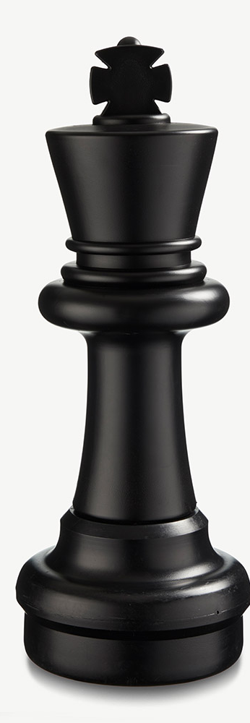
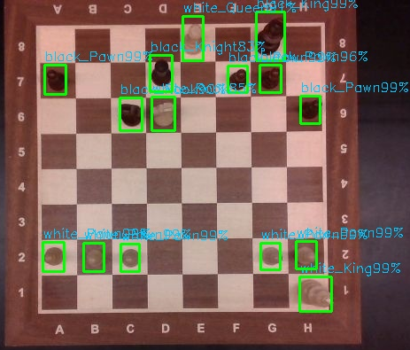
chessPiece Class
Gjergji Luarasi - Grand Master Chess Demo

Slide 22
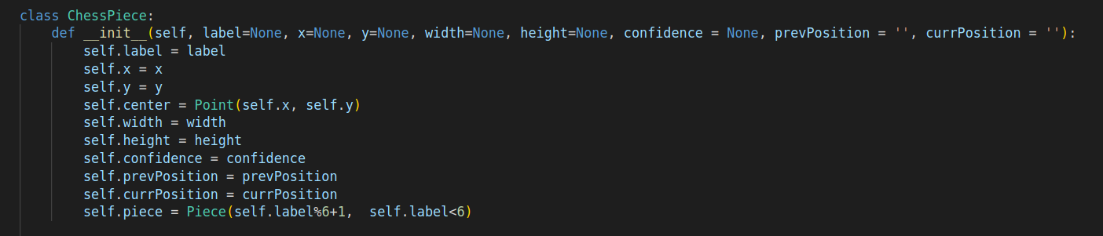
chessPiece initialization function
The chessPiece.__str__ function prints the instance:
ChessPiece(label=white_Pawn, x=374.5, y=208.0, width=19, height=28, confidence=0.9999599456787109, prevPosition=, currPosition=E4)
Gjergji Luarasi - Grand Master Chess Demo

Slide 23
Logging Outputs
GRAND MASTER CHESS
You chose save_images = 0 and show = 0
Playing game in the folder game_path = chess_v4/obj_test_data
---------------------------------------------------------------------------------------------
FRAME 1 SOURCE IMAGE: chess_v4/obj_test_data/5frame0006.jpg
(i) Filter out frames with hands lasted 0.066 s Handedness: None
(ii) Set chess board tiles lasted 0.037 s
(iii) Image loading and preprocessing lasted 0.005 s
(iv) Yolo darknet inference lasted 0.365 s
(v) Chess piece list generation lasted 0.029 s
(vi) Display digital twin chess board lasted 0.280 s
(vii) FRAME 1 lasted 0.786 s/ Frequency = 1.272 Hz
Gjergji Luarasi - Grand Master Chess Demo

Slide 24
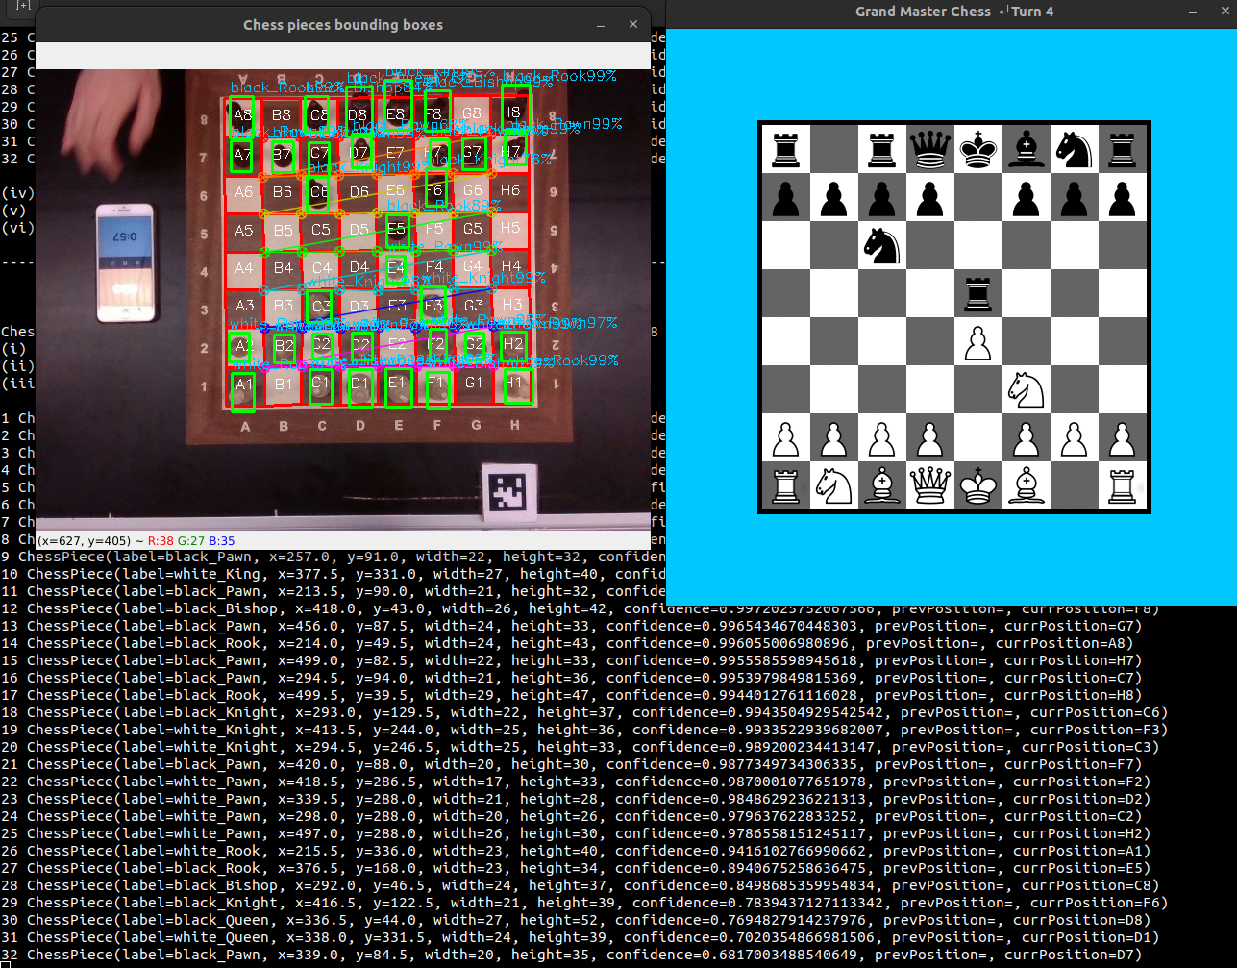
Visualization
Gjergji Luarasi - Grand Master Chess Demo

Slide 25
Recorded Game - Visualization Demo
Gjergji Luarasi - Grand Master Chess Demo

Slide 26
Limitations
The largest part of the execution time for each frame is the yolo inference time, which amounts for approximately 62% of the total execution time.
The mean yolo inference is 300 ms.
This benchmark is tested on a intel core i7 8th gen cpu.
Another value I got was 6.3 s which is my old intel pentium dual core PC from 2014 :)
This means that the real time realization for this project is mainly based on the hardware, since a powerful gpu could reduce the inference time to 26 ms and thus have higher frame sampling frequency.
Gjergji Luarasi - Grand Master Chess Demo

Slide 27
Conclusion & Future Work
Couple of keypoints open to improvement:
Creating a bigger dataset
Train Yolo with multiview data
State refinement feature to correct false outputs
Use prevPosition to check whether a move is illegal
Chess engine to suggest best move in the detected frame
Gjergji Luarasi - Grand Master Chess Demo

Slide 28
THANK YOU !
Any questions?
Berkay Silsüpür / Gjergji Luarasi - Grand Master Chess Demo

